Slide 1
Databases and DBMS
420-D10 Database I – S02
References:

Slide 2
Objectives
The big picture
What is a database
Why would you want one?
What is a DBMS?
Benefits, costs, risks
Why use them?
How are they deployed?

Slide 3
Computer science
Computer Science
Data
Information and coding theory
Storage, retrieval
Algorithms
Transforms, manipulate
Notes:
Computer science is really about data and the transformation of data using some algorithm.
On the data side, we learn best ways to structure data – formatting, sorting, trees, etc.

Slide 4
Data is important
Recall 420-E01-HR (Business Information Systems)
Data is the life blood of modern businesses
How to keep track of:
Customers
Vendors
Products & Services
Transactions
Notes:
Where to store all this important data?
Whiteboard walk thru
Use case - When you register as a new account on a server, where does that information go? It must be stored.
Is storage the main purpose?
No – need to retrieve it easily for analysis and operations
i.e. validate you’re a customer, lookup your activity (what products and services you’ve received, say to bill you).

Slide 5
Use case for a database
(We’ll get around to a formal definition of a database later)
Walk through of:
New account registration
Purchase/ordering of goods and services
Delivery of goods and services
Billing for goods and services
Processing payment received
Notes:
Tbd: build up use case (in class)

Slide 6
Definition
Databases are used to store, manipulate and retrieve data
Definition
An organized collection of logically related data
Notes:
Make a top ten list – is this a database?
In most cases yes.
Class activity – brainstorm what is a database – excel table? Phone book?

Slide 7
Definition - breakdown
Definition
An organized collection of logically related data
Data
Facts, text, graphics, images, sounds, videos
Organized
Structured so as to be easily stored, manipulated and retrieved
Notes:
Class discussion: define Data, define organized and why

Slide 8
Database types
Paper list
Excel spreadsheet
Files (structured)
DataBase Management System (DBMS)
Notes:
You can store your top 10 lists in any of these formats
What then is the benefit of a RDBMS?

Slide 9
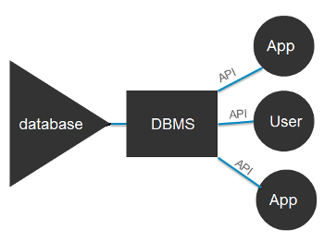
DBMS
Definition:
System software for creating and managing databases.
Notes:
Applications interact with the DBMS to get access to the database

Slide 10
DBMS
Applications interact with the DBMS to get access to the database
Abstracts physical details of the database
Where it is stored
How it is stored
How it is shared
What can be accessed
Notes:
Applications interact with the DBMS to get access to the database
Walk through sequence of user query to dbms; request/response

Slide 11
DBMS - benefits
Program-Data Independence
Data independence is the property that the structure of a database can change without the programs that access the database having to change. With the database approach, data descriptions (i.e. file formats) are stored with the data itself in a repository in the database. This property of database systems allows an organization’s data to change and evolve (within limits) without changing the application programs that process the data.
Planned Data Redundancy
The design goal with the database approach is that previously separate (and redundant) data files are integrated into a single, logical structure. Each primary fact is recorded (ideally) in only one place in the database. For example, if the College systems were converted to a centralized database system, the student address would only be stored in one location. The database approach does not eliminate redundancy entirely, but it enables the designer to control the type and amount of redundancy. For example, the program code is repeated in the Student table to establish the relationship between a student and the program he/she is registered in.
Improved Data Consistency
If data is stored in only one location, there is no opportunity for inconsistency. Also updating data values is greatly simplified when each value is stored in one place only.
Improved Data Sharing
A database is designed as a shared corporate resource. Authorized users are granted permission to use the database, and each user (or group of users) is provided one or more user views to facilitate this use. A user view is a logical description of some portion of the database that is required by a user to perform some task.
If a new application is needed, it can use the existing data in the database - a new file is not necessary.
Notes:
Class interaction: brainstorm this list first
Expand on each of this items with discussion and whiteboard

Slide 12
DBMS - benefits
Increased Productivity of Application Development
Database applications can be much more rapidly developed than conventional file applications because:
1. The programmer can concentrate on the specific functions required for the new application, without having to worry about file design or low-level implementation details. (i.e. The programmer does not have to worry about file management programs.)
2. The database management system provides a number of high-level productivity tools such as forms and report generators and high-level languages that automate some of the activities of database design and implementation.
3. Significant improvement in programmer productivity, sometimes estimated to be as high a 60 percent is currently being realized through the use of Web services (HTTP/S), based on the use of standard Internet protocols and a universally accepted data format (XML).
Enforcement of Standards
one individual or group should be responsible for maintaining the database structure
this group is usually called the Database Administration group or the Database Administrator in the case of an individual
the DBA balances the conflicting demands of different groups within the organization and therefore provides a database that is useful to the whole company
The database administration function enforces single-point authority and responsibility for establishing and enforcing data standards including naming conventions, data quality standards and uniform procedures for accessing, update, and protecting data.
Notes:
Class interaction: brainstorm this list first

Slide 13
DBMS - benefits
Improved Data Quality
A recent report by The Data Warehousing Institute (TDWI) estimated that data quality problems currently cost U.S. businesses some $600 billion each year.
Two ways of improving data quality are:
1. Specifying integrity constraints that are enforced by the DBMS. A constraint is a rule that cannot be violated by dataset users.
Examples:
a rule that a Canadian postal code must be 6 characters long beginning with a letter and alternating letters and digits for the next 5 characters.
a rule that an employee who is allocated a PC must exist in the database
2. Cleaning up or "scrubbing" operational data before they are placed in the data warehouse.
Example:
Do you ever receive multiple copies of a catalogue? The company that sends you three copies of each of its mailing pieces could realize significant postage and printing savings if its data were scrubbed.
Improved Data Accessibility and Responsiveness
End-users without any programming experience or ability can directly retrieve and display data using SQL and QBE.
Reduced Program Maintenance
Because of data independence and reduced redundancy, program maintenance becomes much simpler. Changes to the data format need only be done in the database once for each field.
Increased Security
Modern databases can restrict access to individual attributes of entities thereby ensuring that only authorized individuals have access to the corporation's data.
Notes:
Class interaction: brainstorm this list first

Slide 14
DBMS – costs and risks
New Specialized Personnel
DBMS's are very complex programs that require many choices to be made in designing the database – incorrect decisions can impact greatly on use, flexibility and speed of the database
Require individuals to design and implement, provide database administrations services and manage a staff of new people
Because of rapid changes in technology retraining must be provided on a regular basis
Installation and Management Cost and Complexity
A DBMS is a very large and complex program that has a high initial cost, requires a staff of trained personnel to install and operate, requires megabytes of disk space to store and lots of memory to run and has substantial annual maintenance and support costs.
may require upgrades to the hardware and data communications systems
substantial training is normally required on an ongoing basis to keep up with new releases and upgrades
Conversion Costs
older legacy systems which are based on file processing and/or older database technology can be prohibitively expensive to convert to modern database technology – in terms of dollars, time and organizational commitment.
data warehouses are one way to continue to use older systems while at the same time exploiting modern database technology and techniques.
Need for Explicit Backup and Recovery
Because all the users are now using the same file (database), failure of the database creates problems for all users, not just those using the particular data affected
The process of recovering from a failure is much more difficult because of the complexity of the database and because of the number of users accessing the data
A shared corporate database must be accurate and available at all times
Organizational Conflict
a shared database requires a consensus on data definition and ownership as well as responsibilities for accurate data maintenance
handling conflict issues over these decisions requires organizational commitment to the database approach, organizationally astute database administrators and a sound evolutionary approach to database development.
Notes:
Class interaction: brainstorm this list first

Slide 15
DBMS vs conventional file
Conventional Files | Databases
Easy to design and implement (based on a single application) | Complex to design - need to adhere to rigorous design principles. Need DBMS to provide interface between programmer and data
Fast Processing Speed | Slow - additional processing overhead (often requires purchase of larger computer)
Redundancy - duplicate input, duplicate storage | Little or no redundancy
Integrity problems due to redundant data | Integrity problems due to shared data
Application programs dependent on the structure of the data (DATA DIVISION in COBOL) | Application programs independent of the structure of the data
 | Complexity of backup and recovery
Inflexibility - can't easily accommodate new needs (e.g. file reorganization necessary | More flexible formats - allows us to use the data in ways not originally specified by the end-users
Notes:
Class interaction: brainstorm this list first

Slide 16
DBMS deployment options
Variety of sizes and abilities
Large server environments
Large numbers of shared users
SQL Server, Oracle, MySQL PstgreSQL, DB2
Small desktop/application environments
Access,SQLite

Slide 17
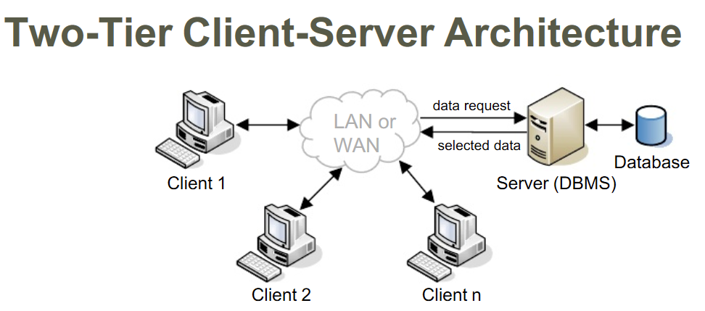
DBMS
Notes:
Typical two tier client-server architecture
Show client – uses some API to communicate with the DBMS
Show

Slide 18
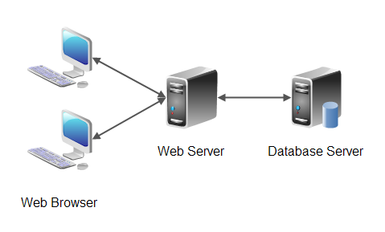
DBMS
Notes:
In this case the “client” in the previous slide is the hosted web application running on the web server which is reaching into the database.
Whiteboard: sequence diagram showing request/response from web browser to web server, database server

Slide 19
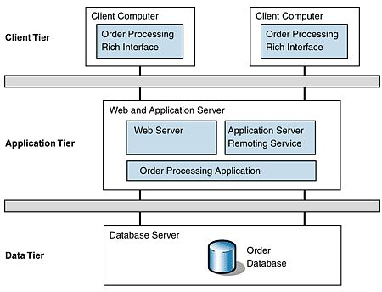
DBMS
Notes:
Just another way of showing the 3 tier architecture
We’ll cover more of this in Systems II (n-tier architectures)

Slide 20
DBMS - personal
It all lives on the same machine
Supports one user or one device
Another process
OR: Linked into the same process (SQLLite, for embedded systems)

